Slide 1

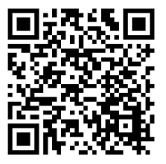


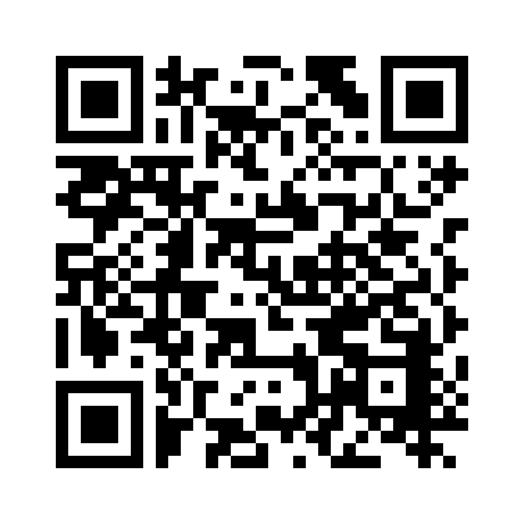
Dallas County
As a UnitedHealthcare member, you’ll have access to certain programs, tools and resources designed to help you stay healthier and save money.
Scan the QR codes to learn more.
PEBC- 2024 Open Enrollment Presentation
https://www.brainshark.com/uhc/vu?pi=zH0zcb0GJzm7iVz0
Scan QR code with your phone's camera or QR reader
PEBC- 2024 Wellness Program Presentation
https://www.brainshark.com/uhc/vu?pi=zGxz11YFP3zm7iVz0
Rally®
A path to better health. Get personalized recommendations designed to help improve your health and have fun doing it.
Scan QR code with your phone's camera or QR reader

Slide 2

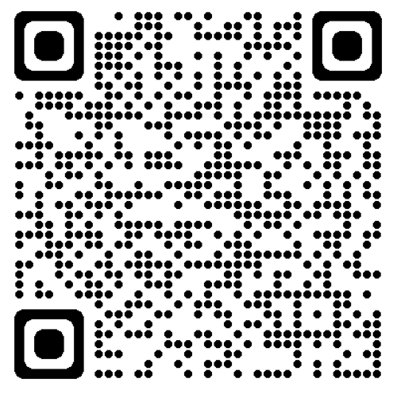
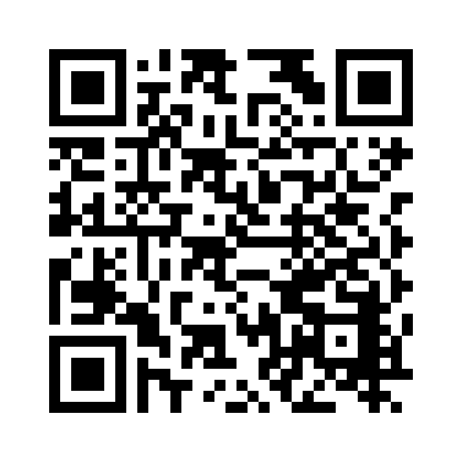

The UnitedHealthcare® app puts your plan at your fingertips.
When you’re out and about, you can do everything from managing your plan to getting convenient care. Just download the app
Scan QR code with your phone's camera or QR reader
https://uhc.video.uhc.com/media/UHC+Mobile+App+Demo+2024+without+RX/1_xnnw9v4e
Virtual Visits
Get access to care online, anytime. Visit with a doctor 24/7 by video or phone*.
*Data rates may apply.
Scan QR code with your phone's camera or QR reader
https://www.brainshark.com/uhc/vu?pi=zHbzpdeA1zm7iVz0
The UnitedHealthcare® app is available for download for iPhone® or Android®. iPhone is a registered trademark of Apple, Inc. Android is a registered trademark of Google LLC.
Virtual Visits phone and video chat with a doctor are not an insurance product, health care provider or a health plan. Unless otherwise required, benefits are available only when services are delivered through a Designated Virtual Network Provider. Virtual Visits are not intended to address emergency or life-threatening medical conditions and should not be used in those circumstances. Services may not be available at all times, or in all locations, or for all members. Check your benefit plan to determine if these services are available.
SimplyEngaged® is a voluntary program. The information provided under this program is for general informational purposes only and is not intended to be nor should be construed as medical advice. You should consult with an appropriate health care professional to determine what may be right for you. Rewards may be taxable. You should consult with an appropriate tax professional to determine if you have any tax obligations from receiving rewards under this program. If you are unable to meet a standard related to a health factor to obtain a reward under this program, you might qualify for an opportunity to earn the same reward by different means. Contact us at 1-855-215-0230 and we will work with you (and, if necessary, your doctor) to find another way for you to earn the same reward.
Rally Health® provides health and well-being information and support as part of your health plan. It does not provide medical advice or other health services, and is not a substitute for your doctor's care. If you have specific health care needs, consult an appropriate health care professional. Participation in the health survey is voluntary. Your responses will be kept confidential in accordance with the law and will only be used to provide health and wellness recommendations or conduct other plan activities.
The UnitedHealth Premium® designation program is a resource for informational purposes only. Designations are displayed in UnitedHealthcare online physician directories at myuhc.com®. You should always visit myuhc.com for the most current information. Premium designations are a guide to choosing a physician and may be used as one of many factors you consider when choosing a physician. If you already have a physician, you may also wish to confer with him or her for advice on selecting other physicians. You should also discuss designations with a physician before choosing him or her. Physician evaluations have a risk of error and should not be the sole basis for selecting a physician. Please visit myuhc.com for detailed program information and methodologies.
Insurance coverage provided by or through UnitedHealthcare Insurance Company or its affiliates. Administrative services provided by United HealthCare Services, Inc. or their affiliates.
EI20263072 8/20
© 2020 United HealthCare Services, Inc. All Rights Reserved.

